Slide 1
Various visualisations

Slide 2
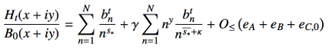
H_{t}(z)-formulae available to explore the negative t-domain
ABB_eff
Direct evaluation in ARB
Very fast
Normalised by B₀
Not valid for t < -6
Direct evaluation in pari/gp
Slow
Fails x > 2000
H_{t}-integral
Direct evaluation in ARB
Slow
Unstable for x > 1000, t < -30
Riemann summation in ARB
Reasonably fast
Unstable t < -100
The lack of a good normalizer like B₀ makes
it difficult to control the rapidly decaying H_{t}.

Slide 3
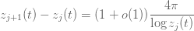
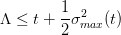
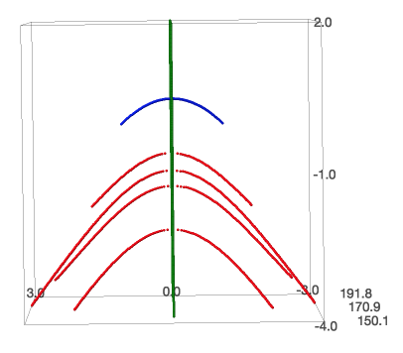
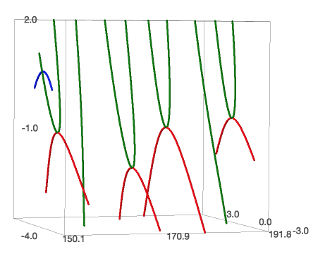
Actual trajectories of real and complex zeros of H_{t}(x+iy) (using ABB_eff formula)
The complex parts of zeros attract each other and the real parts repel each other. From isolating the imaginary “force”, it can be derived that all complex zeroes will be forced into the real axis in a finite time leading to the bound:
Zeroes get denser as one moves away from the origin, so there are more zeros to the right of x_{n} then to the left, hence their trajectories typically “lean” leftwards.
Once a zero becomes real, it stays real forever and ends up roughly equally spaced with:
“solid”
state
0.5
0
0
“liquid”
state
-1
1
t
t
“gaseous”
state
y
x
y
x
trajectory of real zeros
trajectory of complex zeros
DBN-upper bound (still drawn at 0.5, is now 0.22)

Slide 4
Observations on the trajectories of real zeros (using H_{t}-integral pari/gp) (1)
1. The collision of some complex zeros appears to occur in a regular pattern at increasingly negative t’s and increasing x.
2. The distance between these lines appears to increase by a fixed factor.
trajectory of real zeros

Slide 5
Observations on the trajectories of real zeros (using H_{t}-Riemann summation) (2)
1. Counted the number of zero pairs that cross the t=0 line between two of the long vertical lines. This gives the series 2, 7, 10, 17, 22, 25,…

Slide 6
Observations on the trajectories of real zeros (using H_{t}-Riemann summation) (3)
1. Have followed the trajectory of the first vertical line all the way up to t = -50000 and it steadily continues its path. Therefore could conjecture that these lines remain real ‘forever’.
2. Why is this line ‘skewed’ to the left compared to the others? Is the reason that real zeros repel each other and since there isn’t any real zero on the left of this line, it get’s repelled to the left?

Slide 7
Observations on the trajectories of real zeros (using H_{t}-Riemann summation) (4)
1. Up to x = 10000 the pattern remains.

Slide 8
Observations on the trajectories of real zeros (using H_{t}-Riemann summation) (5)
1. Up to x = 15000 the pattern remains.

Slide 9
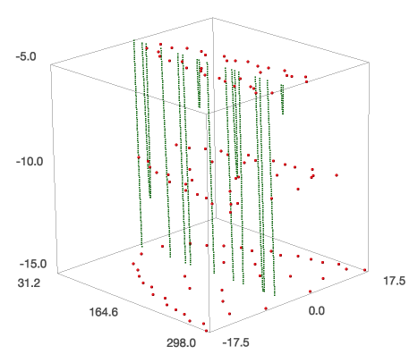
Observations on the density of complex zeros (using H_{t}-Riemann summation)
t
real zeros
x
y
complex zeros

Slide 10
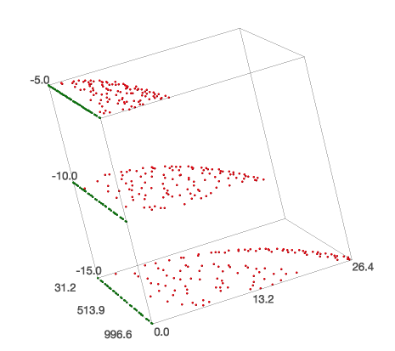
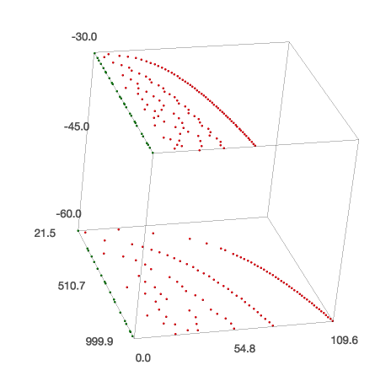
Observations on the density of complex zeros (using H_{t}-Riemann summation)
1. Complex zeros appear to have a maximum on their imaginary parts that increases with x and -t.
t
t
x
x
y
y
real zeros
2. For increasingly negative t, the imaginary parts of complex zeros appear to arrange themselves on curves.
complex zeros

Slide 11
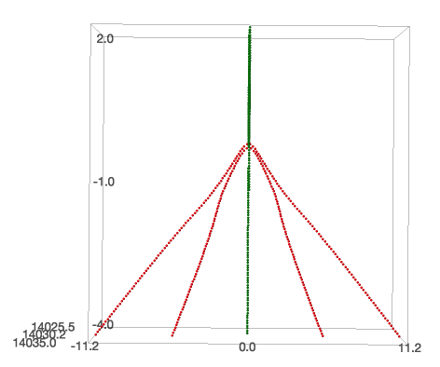
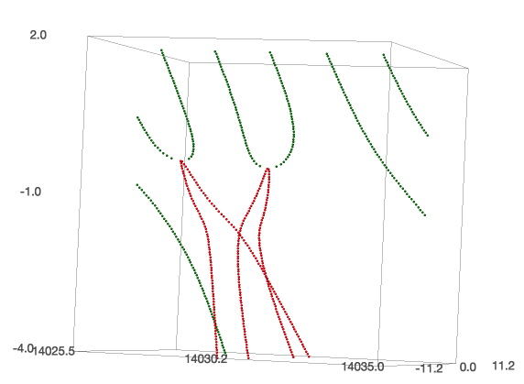
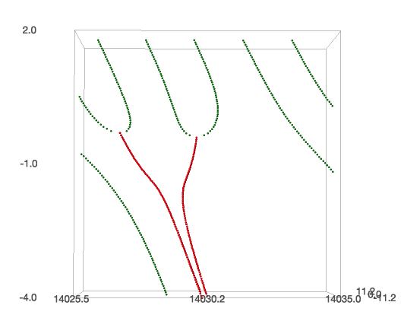
Trajectories complex zeros apparently can’t cross each other (using ABB_eff formula) (1)
1. The attractive force between the conjugates can be stronger than the horizontal force (from the higher density of zeros on the right).
t
t
t
x
y
y
x
y
x
trajectory of real zeros
2. Complex zeros appear to travel in “x-lanes” across time, i.e. a complex zero is not allowed to fly beneath another complex zero. Or stronger: at a certain t, there can exist only 1 pair of complex zeros for a certain x.
trajectory of complex zeros

Slide 12
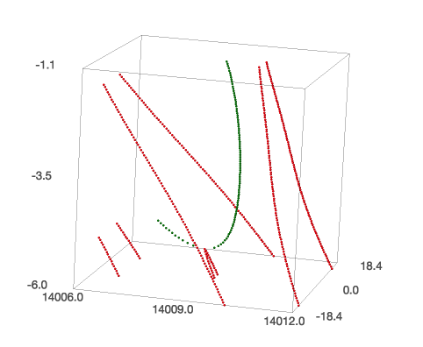
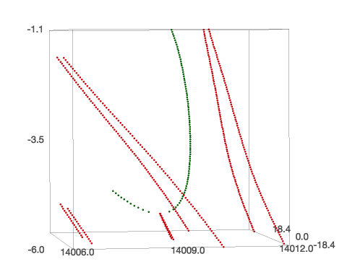
Trajectories complex zeros apparently can’t cross each other (using ABB_eff formula) (2)
1. As soon as a pair of complex zeros has collided, another pair of complex zeros is allowed to fly over it (i.e. the x-‘lane’ barrier is gone then).
t
t
y
y
x
x
trajectory of real zeros
trajectory of complex zeros

Slide 13
Appendix
Few graphs for illustrative purposes only

Slide 14
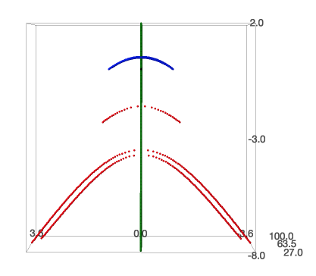
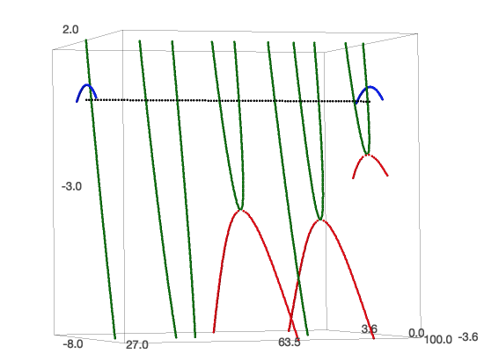
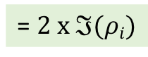
Just the first few zeros (using ABB_eff formula)
= $2 x ℑ(ρi)$
0
0
t
t
y
x
y
x
trajectory of real zeros
trajectory of complex zeros
DBN-upper bound (still drawn at 0.5, is now 0.22)

Slide 15
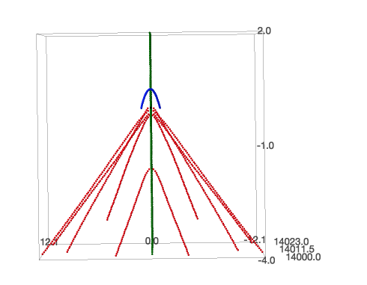
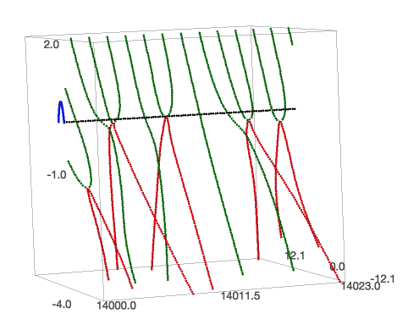
Some ‘turbulence’ around the first Lehmer pair (using ABB_eff formula)
First Lehmer pair
0
0
t
t
y
x
y
x
trajectory of real zeros
trajectory of complex zeros
DBN-upper bound (still drawn at 0.5, is now 0.22)

Slide 16
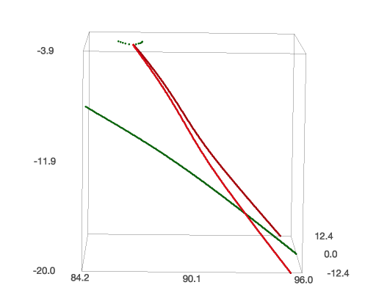
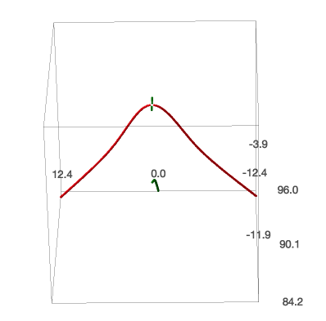
Trajectory of a real zero ‘flying beneath’ a pair of complex zeros
y
t
y
t
x
y
x
1. Example of a trajectory of a real zero flying beneath a pair a complex zeros and thereby apparently inducing an acceleration of the complex zeros (i.e. slowing down their falling speed)
trajectory of real zeros
trajectory of complex zeros

Slide 17
Trajectories complex zeros apparently can’t cross each other
1. The attractive force between the conjugates can be stronger than the horizontal force (from the higher density of zeros on the right).
t
t
t
x
y
y
x
y
x
trajectory of real zeros
2. Complex zeros appear to travel in “x-lanes” across time, i.e. a complex zero is not allowed to fly beneath another complex zero. Or stronger: at a certain t, there can exist only 1 pair of complex zeros for a certain x.
trajectory of complex zeros

Slide 18
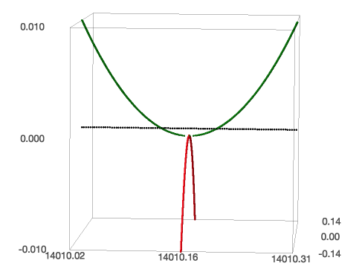
Zooming in on the first Lehmer pair (using ABB_eff formula)
t
y
x
trajectory of real zeros
trajectory of complex zeros

Slide 19
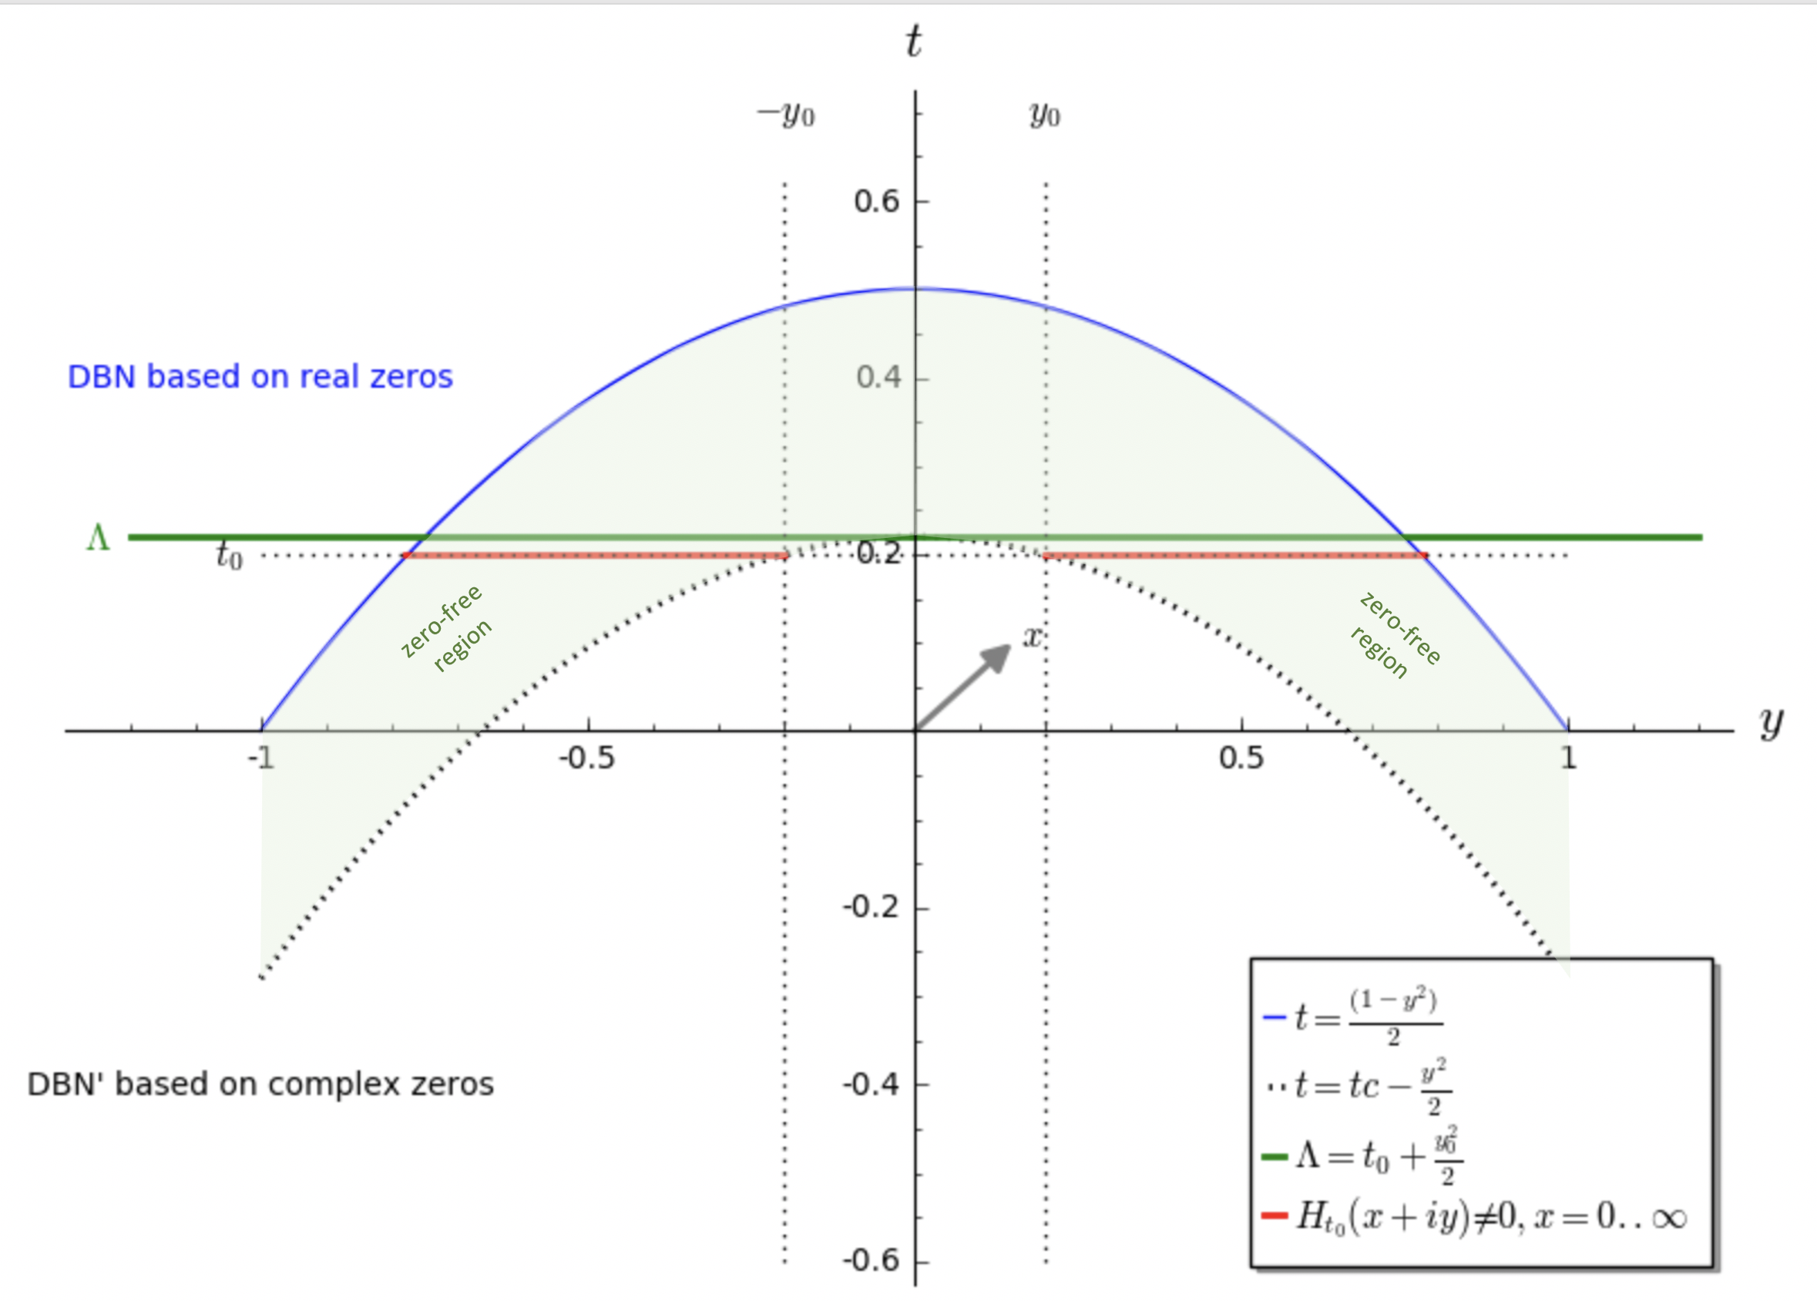
Other visuals

Slide 20
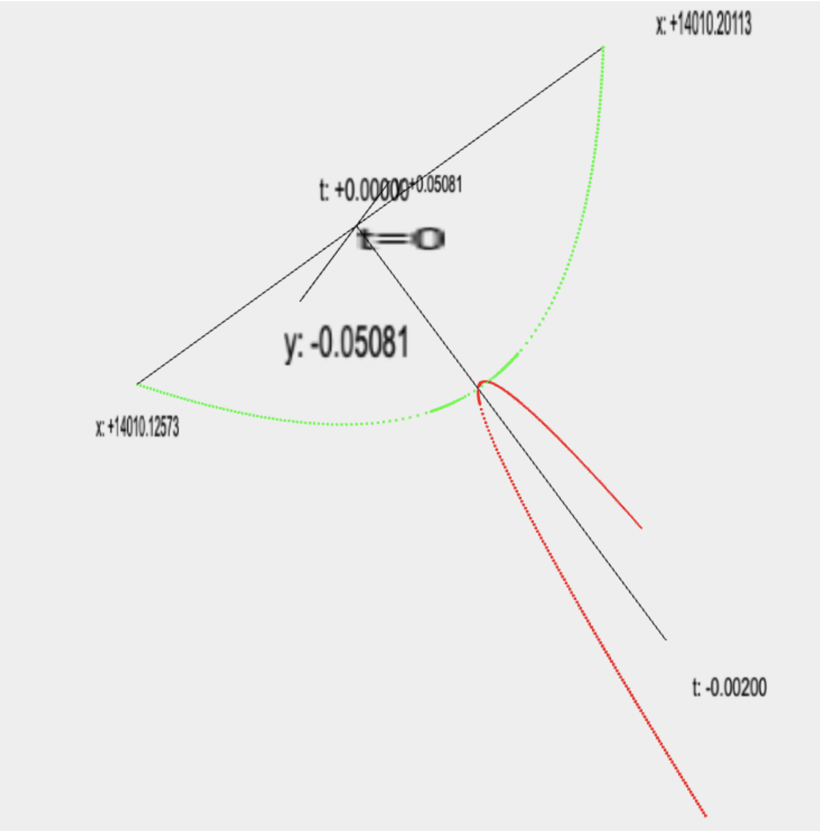
What a failure of the RH would look like.
Real zeros
t = 0.2
-1
t = 0
x
1
t
y
Complex zeros

